Slide 1
Outside Cover

Slide 2
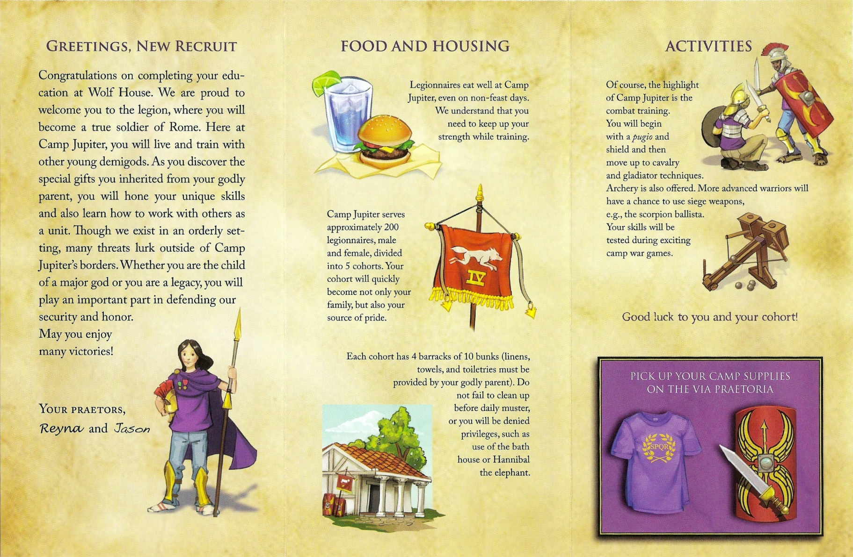
Inside Cover

